Slide 1
DRUG CLASSIFICATION MODEL
Ayush Kumar 2105955
Adya Singh 21051793
Akashika Anshum 21052223
Anmol Kumar Singh 21052230

Slide 2
Content:
Introduction
Objective
Methodology
Result
Conclusion
References

Slide 3
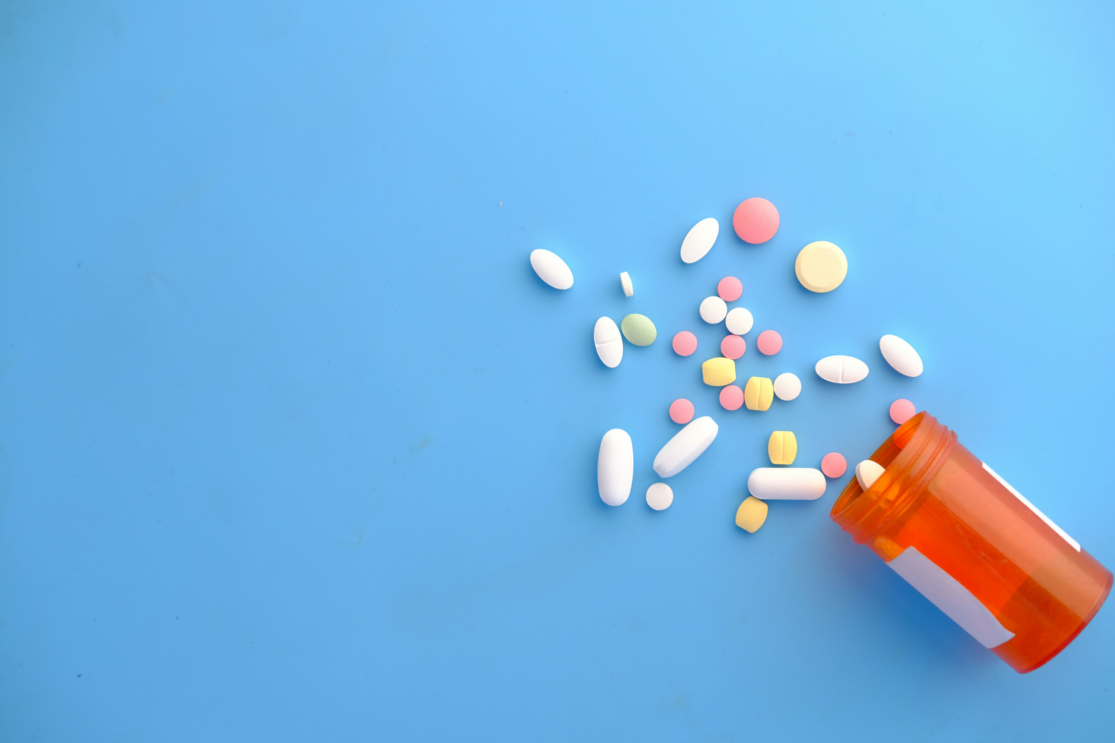
Introduction:
National Institute of Health (NIH) reported that nearly 98,000 people die annually, because of mistakes committed by medical professionals in hospitals in a ratio of 1:5 doses. Deaths in India, due to adverse drug reactions (ADRs) are estimated to be around 400,000 annually in 720,000 ADRs
Regardless of advances in medical technology solutions currently available do not provide reliable drug classification often.
Goal is to tackle this urgent problem by using machine learning (ML) techniques to build a predictive model which can classify drug based on patient characteristics accurately.

Slide 4
Objective:
To build a robust model for drug classification using hyperparameter tuning with the help of Grid Search with five fold cross validation technique for the precise and accurate prediction of machine learning model and improve the healthcare society.
To find the best parameters for the machine models to train with.

Slide 5
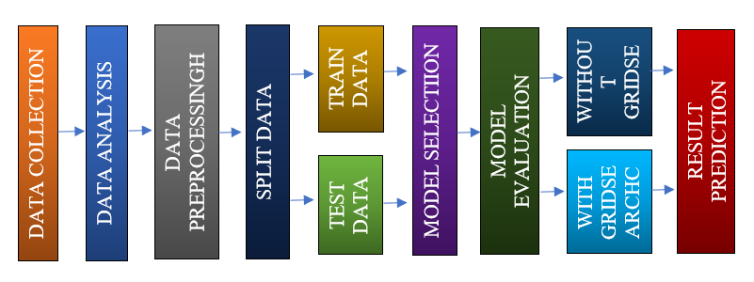
Methodology:
Figure beside shows the methodologies followed in this project.
Downloaded data set from Kaggel which has
200 rows: Individual patients
6 columns: Attributes of patient
Attributes:
Feature variable: Age, Sex, BP, Cholesterol, Na_to_K.
Target variable: Drug

Slide 6
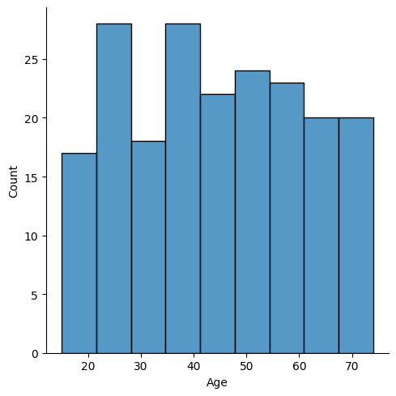
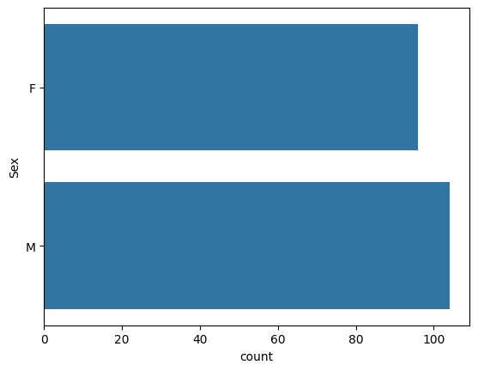
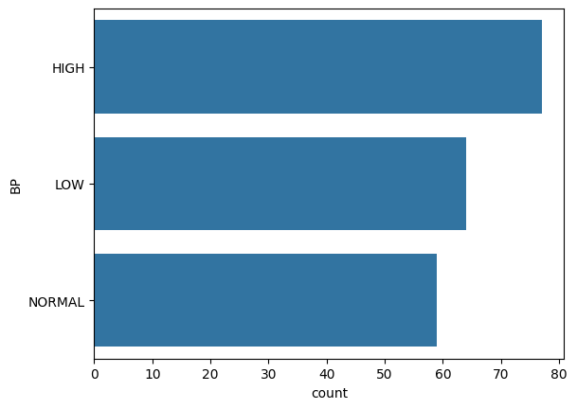
Methodology:
Data preparation/Data Cleaning
Data Analysis:
Exploratory data analysis
Relationship between feature-target variable.

Slide 7
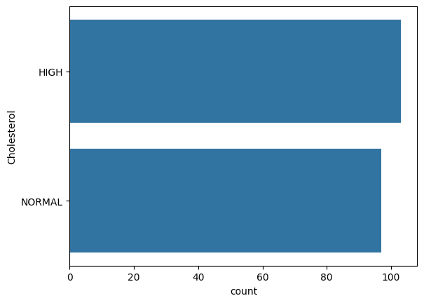
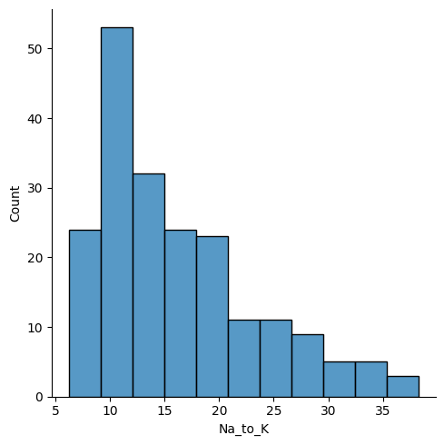
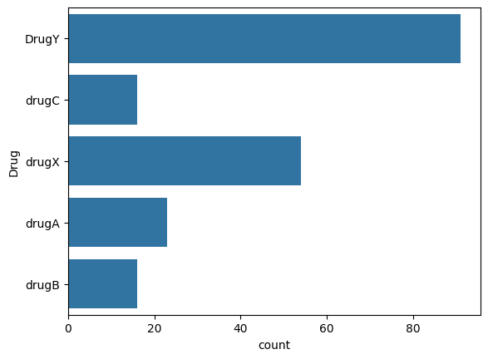
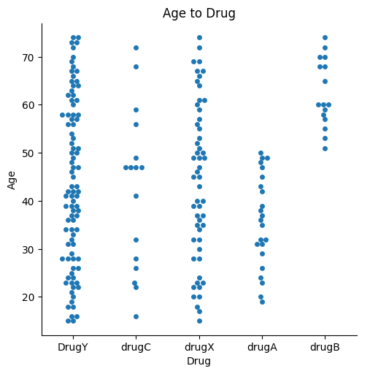
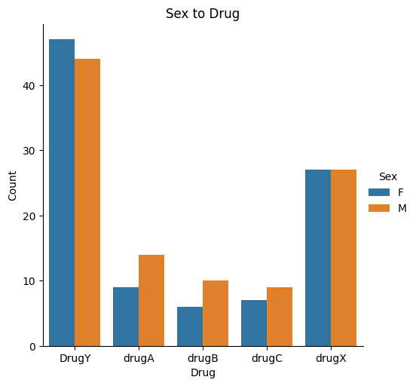
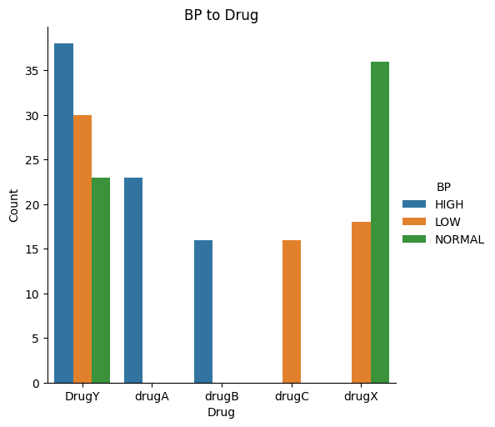
Methodology:
g

Slide 8
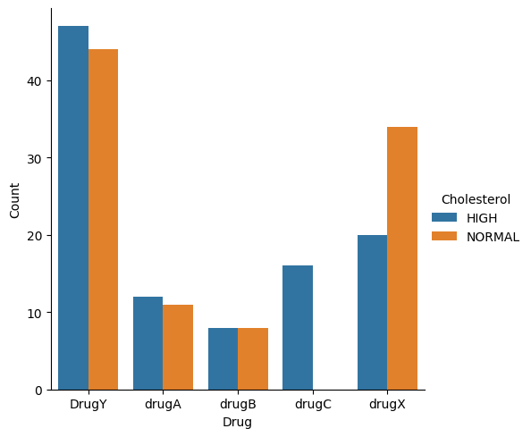
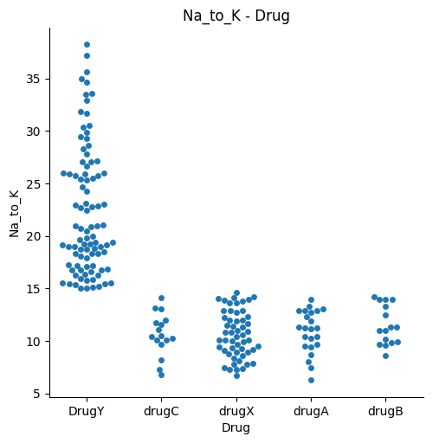
Methodology:
Label Encoding to convert categorical variable to numerical form.
Sex, BP, Cholesterol, Na_to_K, Drug.
Data splitting
80% data for training and 20% data for testing.
Model Selection
KNN, Logistic Regression, Naive Bayes, Random Forest

Slide 9
Methodology:
Model Evaluation
Without GridSearchCV
With GridSearchCV: Hyperparameter tuning with 5 fold cross validation to increase performance of the model.
In training of Random Forest with grid it's score increases from 0.9875 to 0.99375
MODELS | Accuracy (without GridSearchCV) | Accuracy (with GridSearchCV)
K-Nearest Neighbors | 70% | 75%
Logistic Regression | 87.5% | 100%
Naive Bayes | 100% | 100%
Random Forest | 97.5% | 97.5%

Slide 10
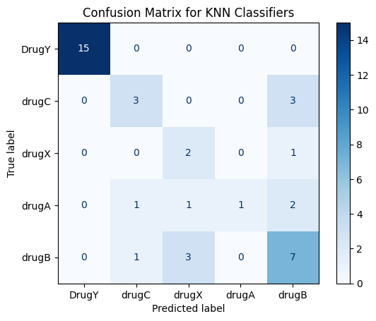
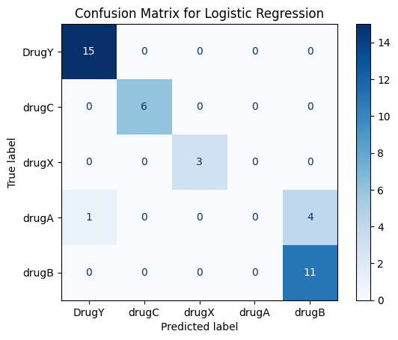
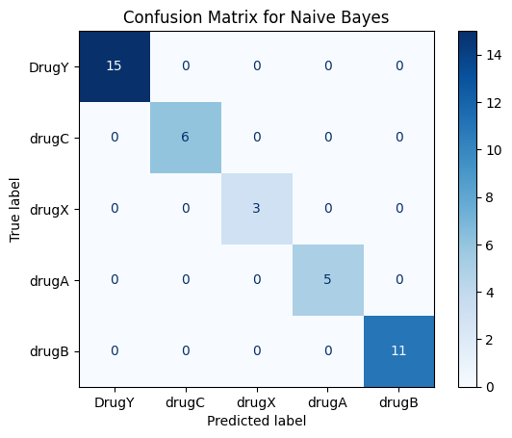
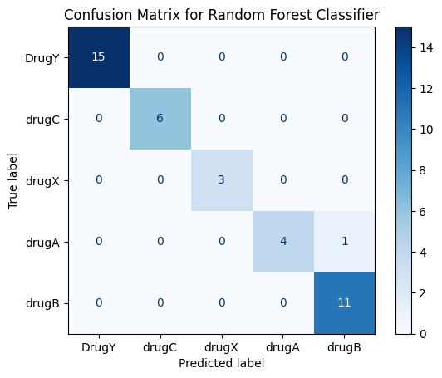
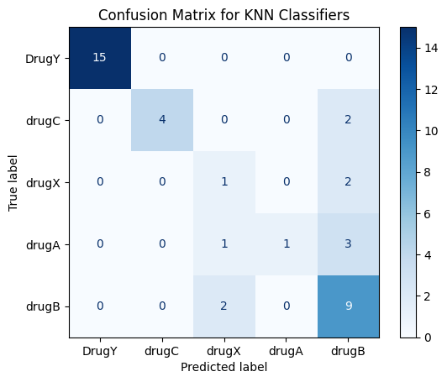

Result:
Change in matrix of Logistic Regression.
Naive Bayes generally does not have any hyperparameter.

Slide 11
Result:
Report without Grid: Report with Grid:
Random Forest is the best option.
So do the Logistic Regression.
MODEL | PRECI | SION | REC | ALL | F1-S | CORE
 | Macro Avg | Weighted Avg | Macro Avg | Weighted Avg | Macro Avg | Weighted Avg
K-Nearest Neighbour | 0.69 | 0.76 | 0.60 | 0.70 | 0.58 | 0.69
Logistic Regression | 0.73 | 0.78 | 0.80 | 0.88 | 0.76 | 0.82
Naive Bayes | 1.00 | 1.00 | 1.00 | 1.00 | 1.00 | 1.00
Random Forest | 1.00 | 1.00 | 1.00 | 1.00 | 1.00 | 1.00
MODEL | PRECI | SION | REC | ALL | F1-S | CORE
 | Macro Avg | Weighted Avg | Macro Avg | Weighted Avg | Macro Avg | Weighted Avg
K-Nearest Neighbour | 0.76 | 0.82 | 0.60 | 0.75 | 0.62 | 0.74
Logistic Regression | 0.73 | 0.78 | 0.80 | 0.88 | 0.76 | 0.82
Naive Bayes | 0.73 | 0.78 | 0.80 | 0.88 | 0.76 | 0.72
Random Forest | 1.00 | 1.00 | 1.00 | 1.00 | 1.00 | 1.00

Slide 12
Conclusion:
A predictive model for drug classification on the basis of various attributes of a patient has been positively established leading in the completion of objective of our project. For drug classification tasks, the efficiency of machine learning techniques being used can give more precise and accurate output using hyperparameters tuning through grid search with 5 fold cross validation technique.

Slide 13
References:
[1]Gala, Dhrumil Vinil et al. “Drug Classification using Machine Learning and Interpretability.” 2021 Smart Technologies, Communication and Robotics (STCR) (2021): 1-8.
[2]Mridha, Krishna & Bappon, Suborno Deb & Sabuj, Shahriar & Sarker, Tasnim. (2024). Explainable Machine Learning for Drug Classification. 10.1007/978-981-99-8661-3_48.

